Slide 1
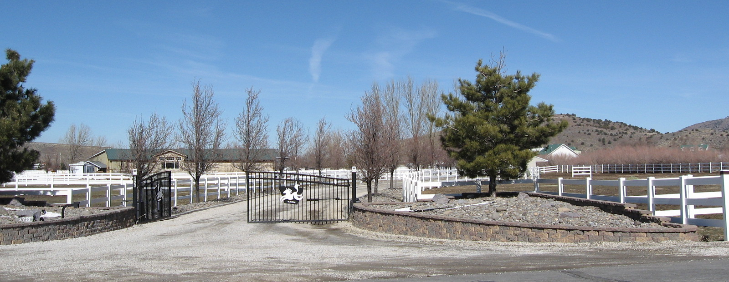
Washoe County Board of Adjustment
April 6, 2017
Special Use Permit Case Number WSUP17-0003 (UDS Barn, LLC – Commercial Stables)

Slide 2
Case Description
For possible action, hearing and discussion, to approve a special use permit for a commercial stables for training of up to 25 horses at one time and for construction of an indoor riding arena of approximately 20,000 square feet.

Slide 3
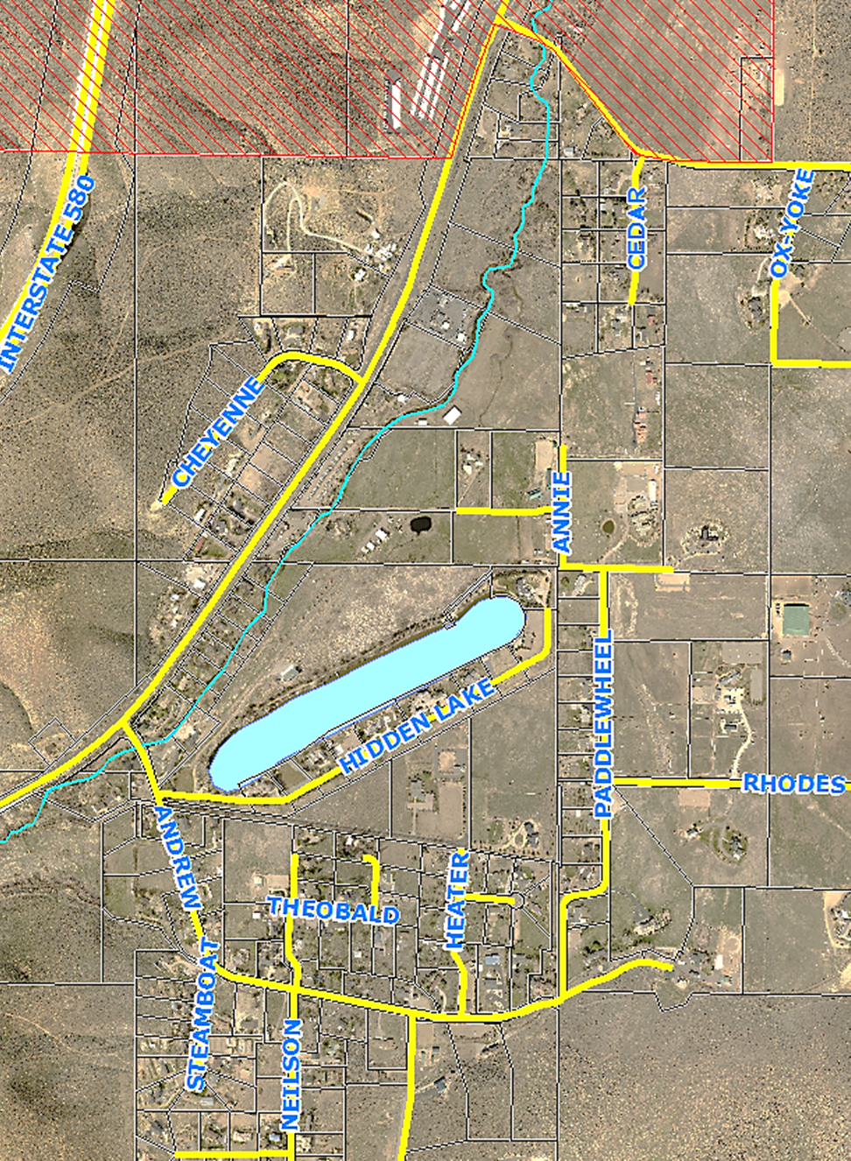
Vicinity Map

Slide 4
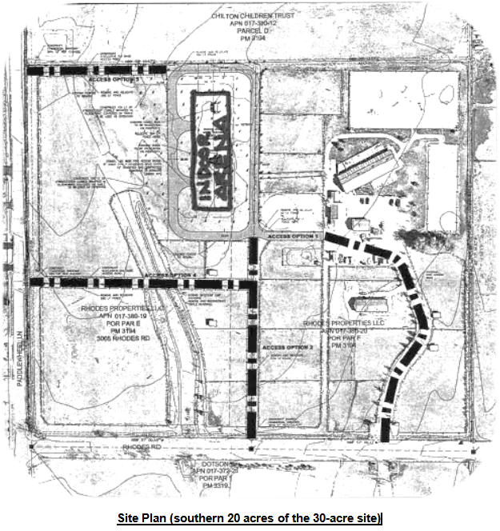
Site Plan (southern 20 acres of the 30-acre site)

Slide 5
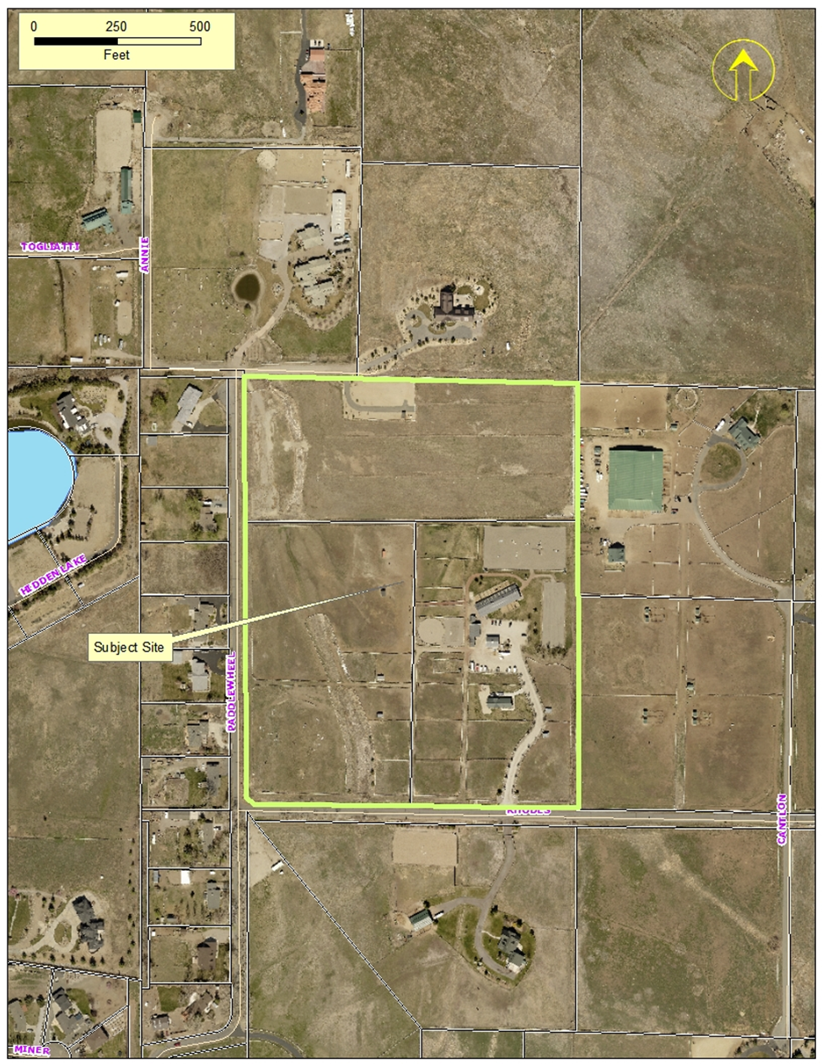
Overall Project Site

Slide 6
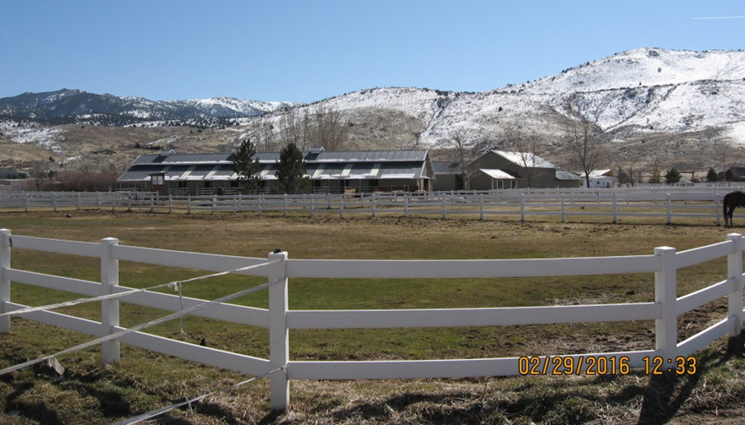
Current Photo of Subject Site

Slide 7
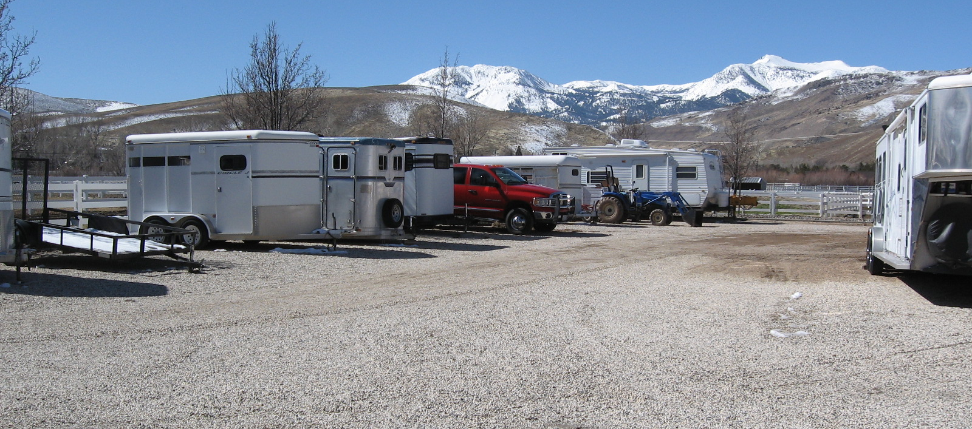
Current Photo of Subject Site

Slide 8
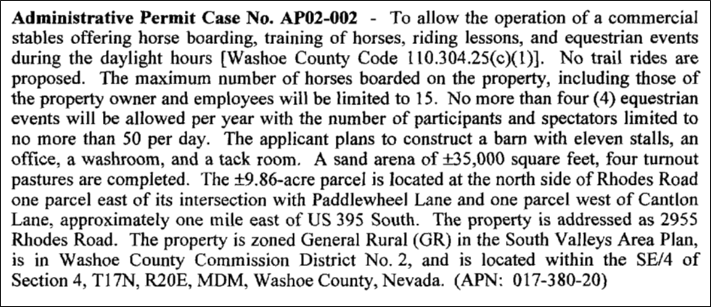
Background
Administrative Permit approved in 2002:

Slide 9
Background
Expiration of 2002 Administrative Permit:

Slide 10
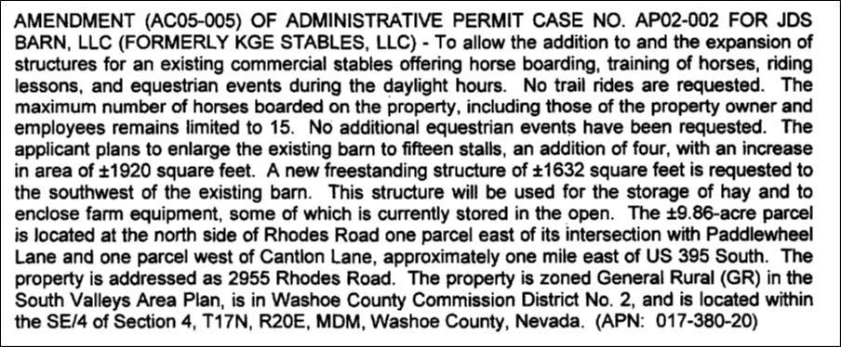
Background
Amendment of Conditions Approved in 2005:

Slide 11
Background
Expiration of 2005 Amended Administrative Permit:
The approval to operate a commercial stable at the subject site expired on July 8, 2015
The commercial stable has not ceased operation

Slide 12
Background
The current request includes:
Re-establish a Commercial Stable on the subject site
Expand the commercial use from approximately 10 acres to approximately 30 acres
Increasing the number of horses to be trained and boarded on the subject site from 15 to 25
Constructing an enclosed riding area of approximately 20,000 square feet

Slide 13
Analysis
South Valleys Area Plan:
“The existence of livestock, particularly horses and cattle, for recreational, economic and educational purposes is commonplace and recognized as a significant contributor to the local character.”

Slide 14
Analysis
Re-establishing an approved Commercial Stable on the subject site is unlikely to create significant impact on surrounding properties
Recommended conditions of approval are generally limited to requiring compliance with current standards required by the Development Code
More detail included on pages 9-16 of the Staff Report

Slide 15
Analysis
Very late in the review process, the applicants’ representative submitted a request to the Planning and Development Division asking to amend the application.
The requests are that certain parking and landscaping standards be reduced by the Board of Adjustment if the special use permit is approved.
Reduce parking surface from asphalt to gravel
Eliminate required buffer between commercial and residential uses
Staff is not comfortable recommending approval of the elimination of the required buffer and screening adjacent to the residential uses, without the knowledge and consent of the effected homeowners. Staff is, however, comfortable with the reduction in the parking surfacing.

Slide 16
Conditions to Respond to Modification Request (Included with Exhibit A)
Prior to approval of a business license the applicant shall provide a parking plan to the Planning and Development Division that demonstrates compliance with all applicable provisions of WCC 110.410, (Parking and Loading) with the exception of surfacing of the parking area. The surfacing of the parking area shall be gravel or Decomposed Granite and shall be installed in a manner acceptable to the County Engineer and the Truckee Meadows Fire Protection District.
Prior to approval of a business license the applicant shall provide a landscape plan to the Planning and Development Division that demonstrates compliance with all applicable provisions of WCC 110.412, (Landscaping), with the exception that buffering of the commercial use from the residential uses to the north may be reduced to three-rail fencing and one tree every 50 feet along the common property line, if and only if, the applicant provides documentation from the property owners to the north, to the Director of Planning and Development, indicating that the property owners to the north agree to the reduction in standards.

Slide 17
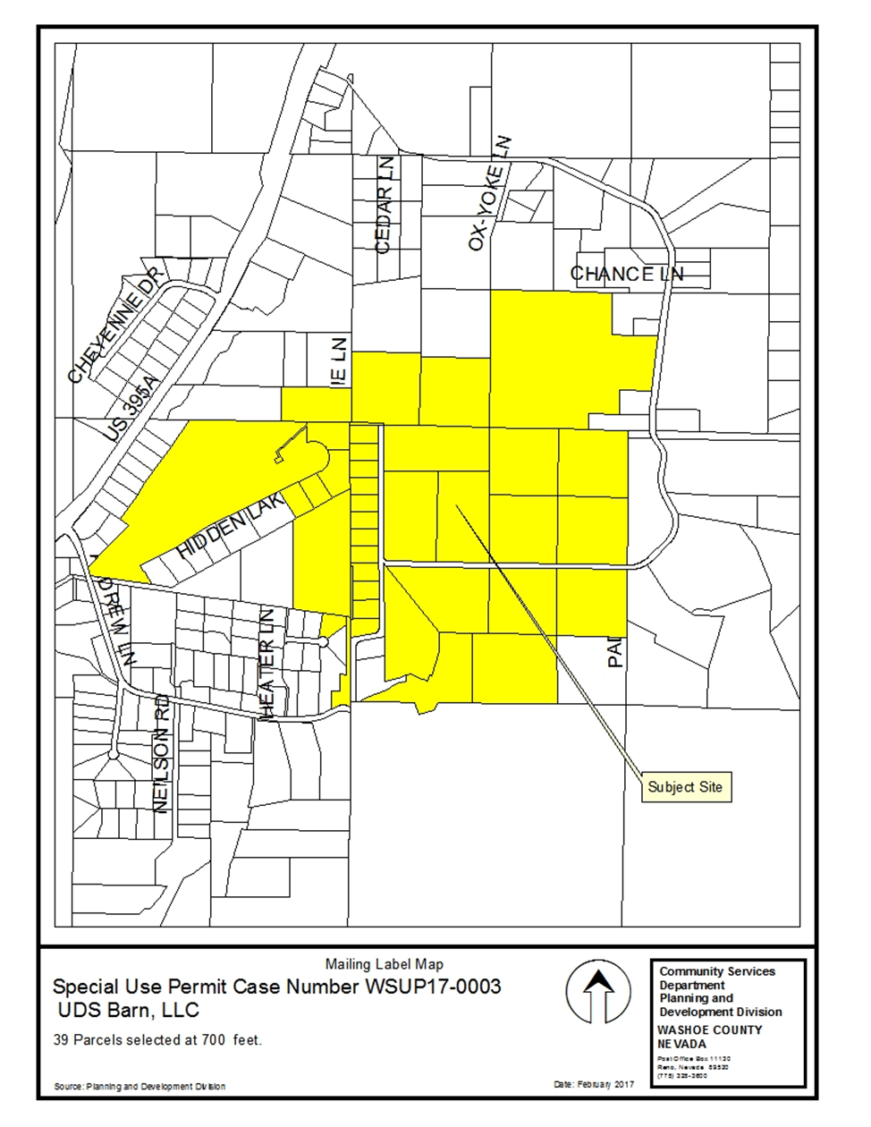
Public
Notice

Slide 18
Conditions of Approval
Conditions of approval have been recommended to ensure compliance with generally applicable code provisions and to ensure compatibility of the proposed riding arena with the existing structures

Slide 19
Special Use Permit Findings

Slide 20
Special Use Permit Findings

Slide 21
Special Use Permit Findings

Slide 22
Special Use Permit Findings

Slide 23
Special Use Permit Findings

Slide 24
Recommendation
After a thorough analysis and review, Special Use Permit Case Number WSUP17-0003 is being recommended for approval with conditions.

Slide 25
Possible Motion
I move that, after giving reasoned consideration to the information contained in the staff report and information received during the public hearing, the Washoe County Board of Adjustment approve Special Use Permit Case Number WSUP17-0003 for UDS Barn, LLC, with the conditions of approval included as Exhibit A for this matter, having made all five findings in accordance with Washoe County Development Code Section 110.810.30

Slide 26
Questions?

